Slide 1


Spatiotemporal assessment of air quality:Urban impact,campus infiltration,and indoor variations at NIT Warangal
19 April, 2025

Slide 2
PRESENTATION HIGHLIGHTS
Introduction
Problem Statement
Objectives of the Study
Literature Review Highlights
Methodology
Observations & Results
Conclusion & Recommendations
Challenges & Limitations
References

Slide 3

INTRODUCTION
Indoor Air Quality (IAQ) is a critical but neglected factor in India’s air pollution studies.
National standards (like NAAQS) focus only on ambient outdoor air, leaving indoor environments unregulated.
Indoor spaces in educational institutions like NIT Warangal are highly occupied and vulnerable, yet understudied.
Previous research shows that direct indoor air quality measurements often fail to reveal the true source or reason behind air pollution levels.
Our study aims to assess IAQ systematically, factoring in outdoor infiltration, wind patterns, and building design to give meaningful insights for real-world decisions.

Slide 4
PROBLEM STATEMENT
Indoor air quality (IAQ) assessments in India are often oversimplified, relying on direct spot measurements that fail to capture the root causes of air pollution. Factors like outdoor pollution, wind direction, building orientation, and infiltration pathways are mostly ignored, especially in campus environments like NIT Warangal leading to incomplete or misleading conclusions.
Our study bridges this gap by focusing on outdoor-to-indoor infiltration, boundary conditions, and wind patterns, aiming to capture worst-case scenarios and offer a more meaningful evaluation of IAQ in NIT Warangal.

Slide 5

LITERATURE REVIEW
AUTHOR(s) & YEAR | STUDY FOCUS | METHODOLOGY | KEY FINDINGS
Asrani & Shah (2024) | Review on indoor air quality in Indian buildings | Literature review of IAQ studies across residential and non-residential structures in India | Found Indian IAQ research often lacks focus on infiltration pathways and outdoor-indoor dynamics, highlighting the need for campus and boundary-based analysis.
Datta et al. (2017) | Indoor air quality of non-residential urban buildings in Delhi | Field sampling of indoor PM and gaseous pollutants across various urban buildings | Showed indoor PM levels are significantly affected by outdoor air and ventilation conditions, indicating outdoor influence is a key driver for indoor pollution in Indian cities.

Slide 6
AUTHOR(s) & YEAR | STUDY FOCUS | METHODOLOGY | KEY FINDINGS
Shree et al. (2019) | Indoor air quality investigation at primary classrooms in Hamirpur, Himachal Pradesh, India | Measurement of PM2.5, PM10, and CO2 using real-time monitors inside classrooms | Revealed that closed environments without proper ventilation show pollutant build-up even in low-traffic towns, stressing on the role of infiltration and indoor source contribution.
Sahu et al. (2020) | Validation of low-cost sensors in measuring real-time PM10 concentrations at two sites in Delhi NCR | Calibration and statistical comparison between low-cost sensors and reference-grade monitors | Concluded that low-cost sensors provide reliable trends for PM10 in urban Indian settings, enabling affordable indoor and boundary condition assessments for academic campuses.

Slide 7

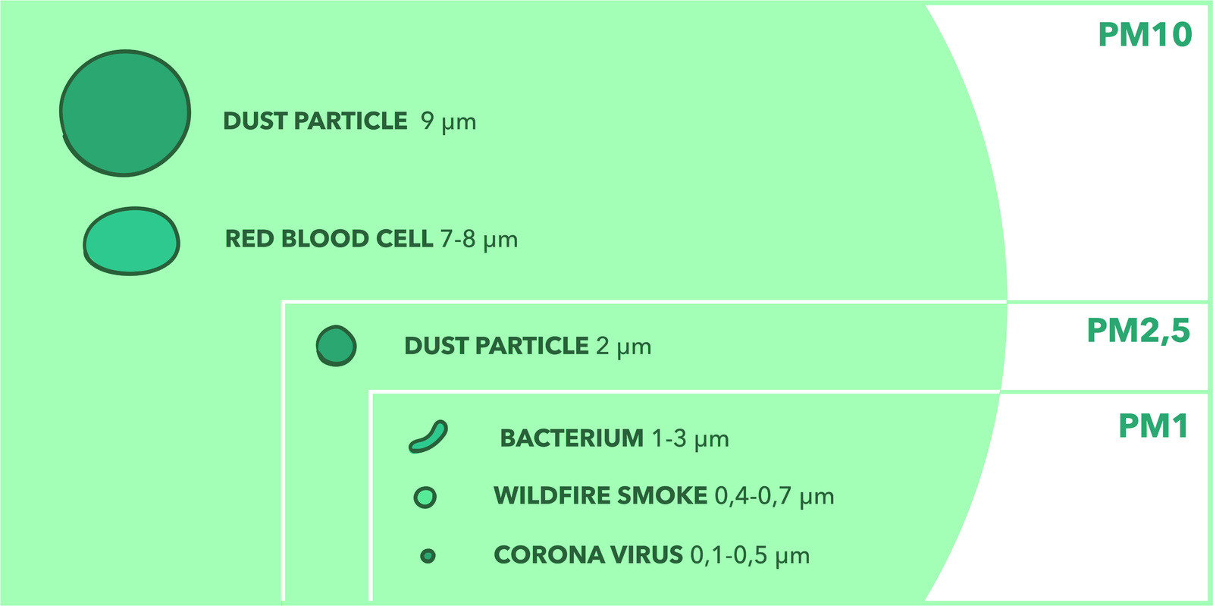
WHAT'S THE DIFFERENCE BETWEEN PM2.5, PM10 AND MORE?
Particulate Matter (PM) includes tiny airborne particles (dust, soot, liquid droplets), with smaller ones being more harmful to health.
PM 1, PM 2.5, and PM 10 refer to particles ≤1 µm, ≤2.5 µm, and ≤10 µm, respectively, with PM 2.5 and PM10 being the most studied due to their deep lung penetration.
Total Suspended Particles (TSP) include all airborne particles up to 100 µm, but larger ones settle quickly and have less health impact.
High Volume Samplers (HVS) are used to measure PM levels over time, helping analyze pollution trends and assess air quality.

Slide 8
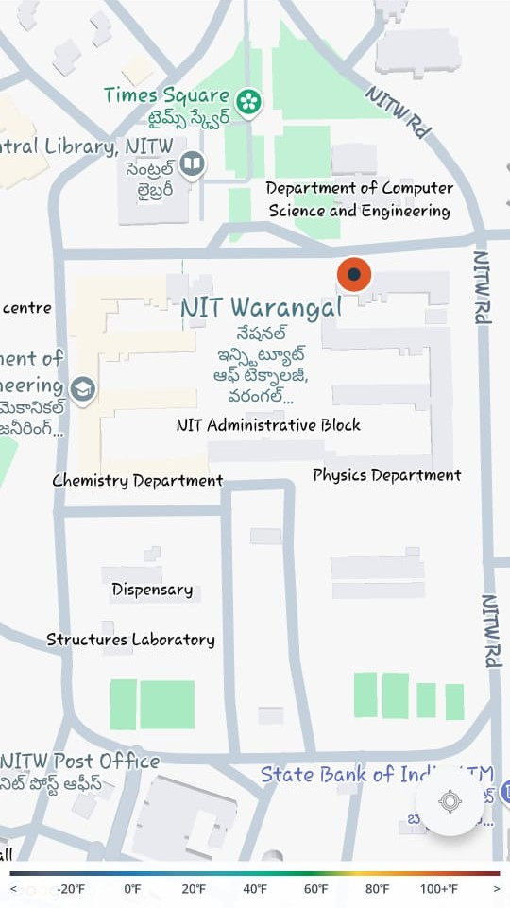
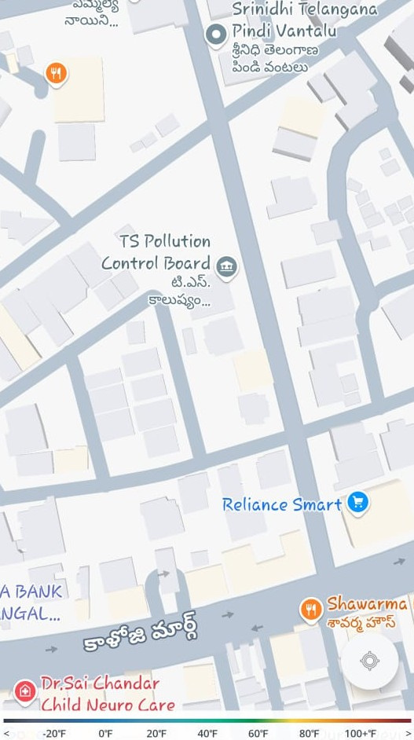
METHODOLOGY PART 1
Year-long Data Collection and Preprocessing
Collected PM2.5 and PM10 data for:
Balasamudram Station (Warangal City) - 1st photo
NIT Warangal AirLink Instrument (cloud‑stored, 15‑minute snapshots) - 2nd photo
Cleaned the dataset by removing anomalies.
Computed monthly averages to compare long‑term trends between city vs. campus.

Slide 9

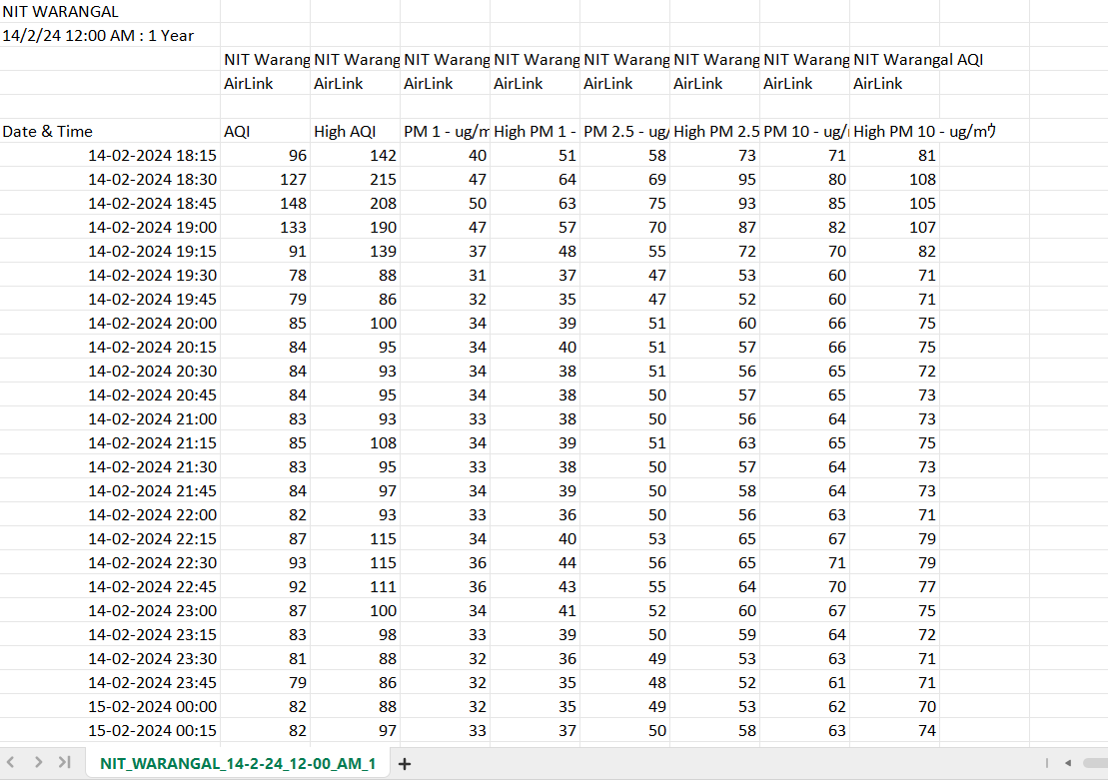
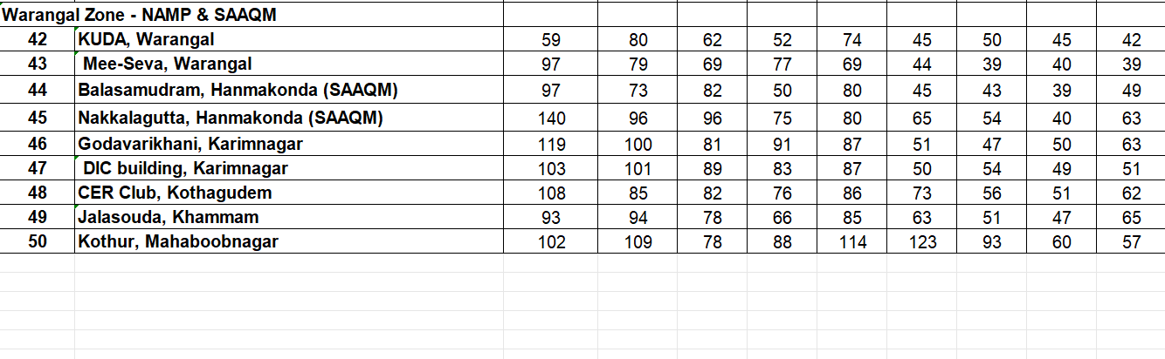
SAMPLE OF DATA COLLECTED
NITW AIRLINK STATION
BALASAMUDRAM STATION

Slide 10
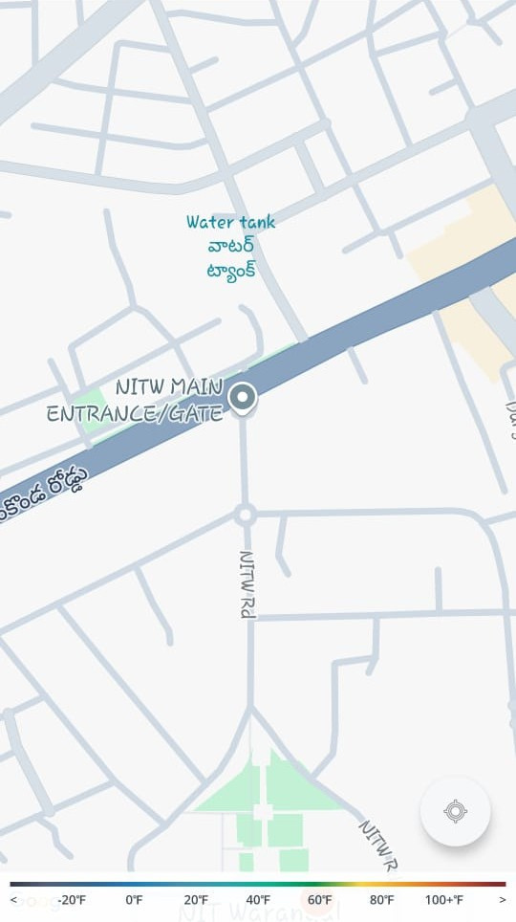
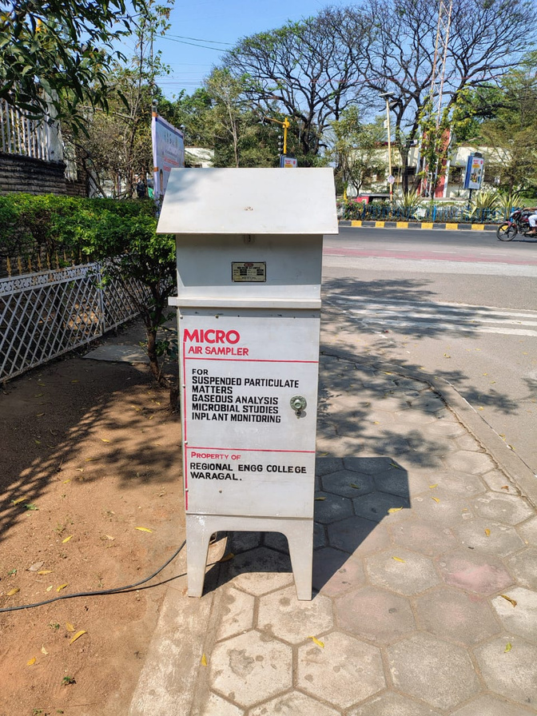

METHODOLOGY PART 2
Boundary Sampling using High Volume Sampler (HVS)
Chose NITW Main Gate based on northeast prevailing winds.
Deployed the High Volume Sampler (HVS):
Ran for 2 hours (standard is 24 hr), then scaled to a 24 hr equivalent.
Goal: quantify the boundary pollutant load to assess infiltration.
NITW MAIN GATE (HVS)

Slide 11
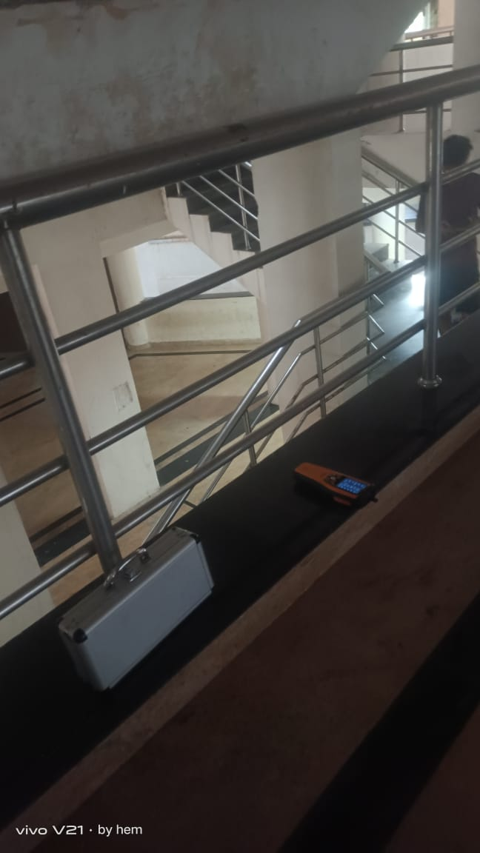
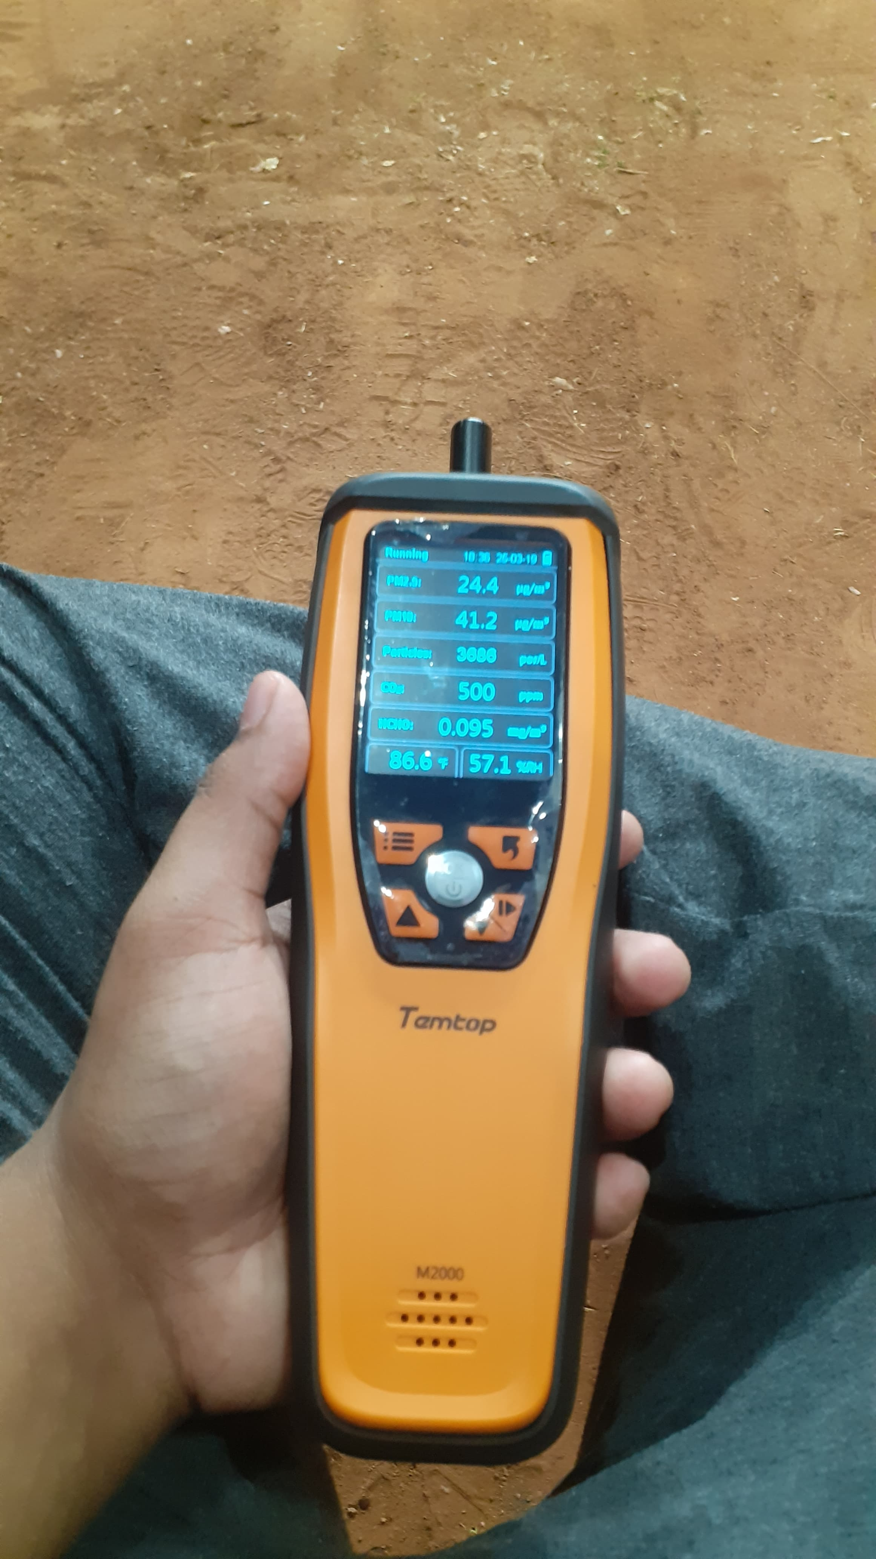

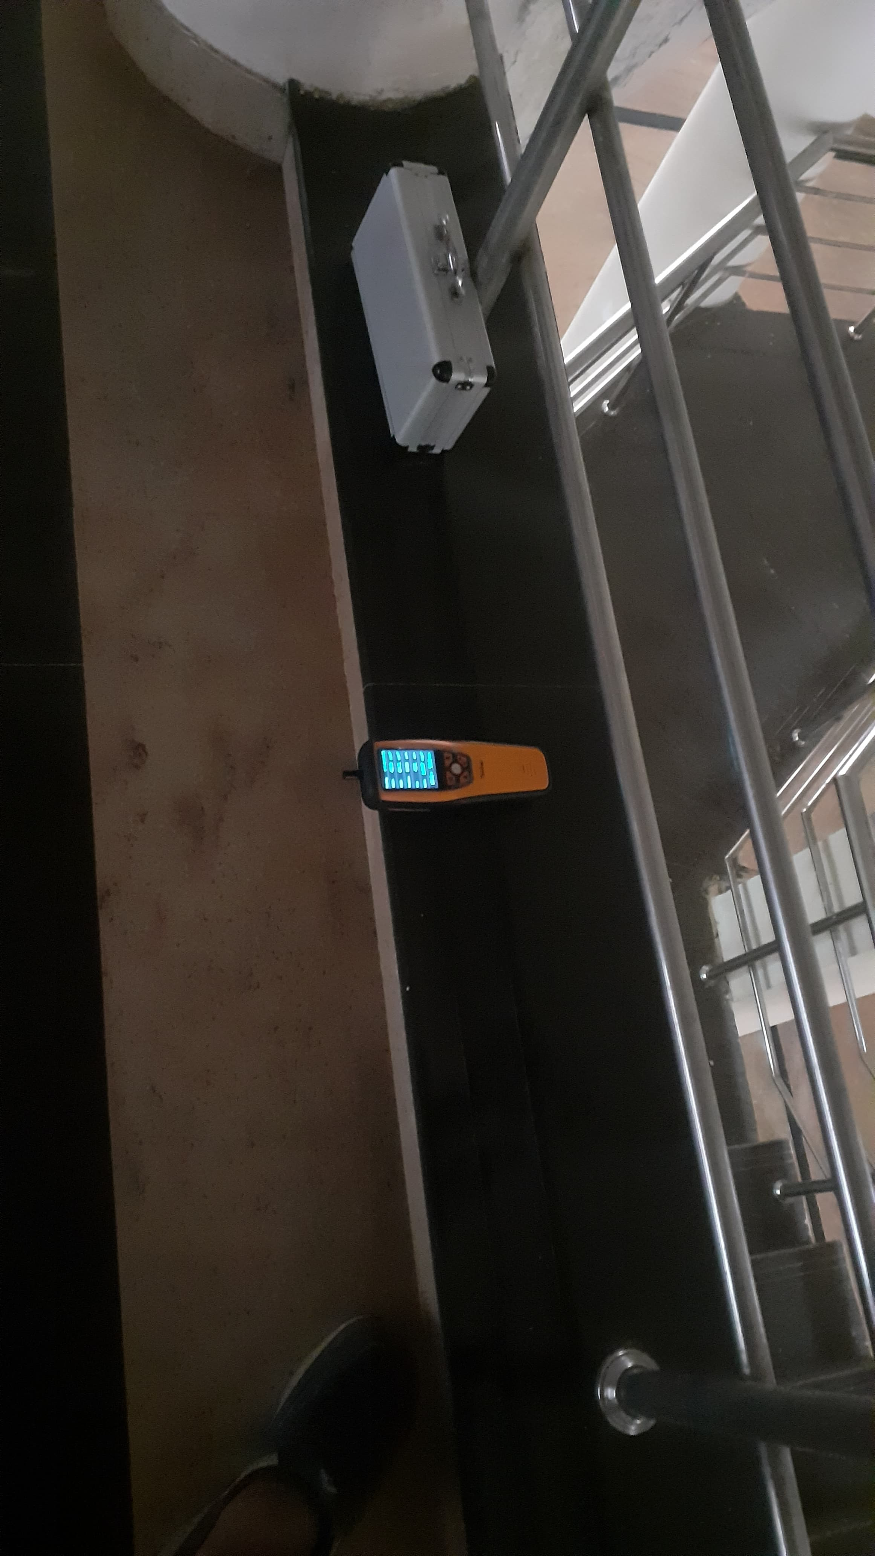
METHODOLOGY PART 3
Temtop‑Based Spatial Sampling Strategy
Targeted southeast‑facing buildings using wind data.
Facility classes:
Closed Spaces (single 15 min reading)
Open Spaces (average of ≥3 readings)
Vertical Distribution (multi‑floor checks)
Instrument: Temtop M2000 for quick snapshots.

Slide 12
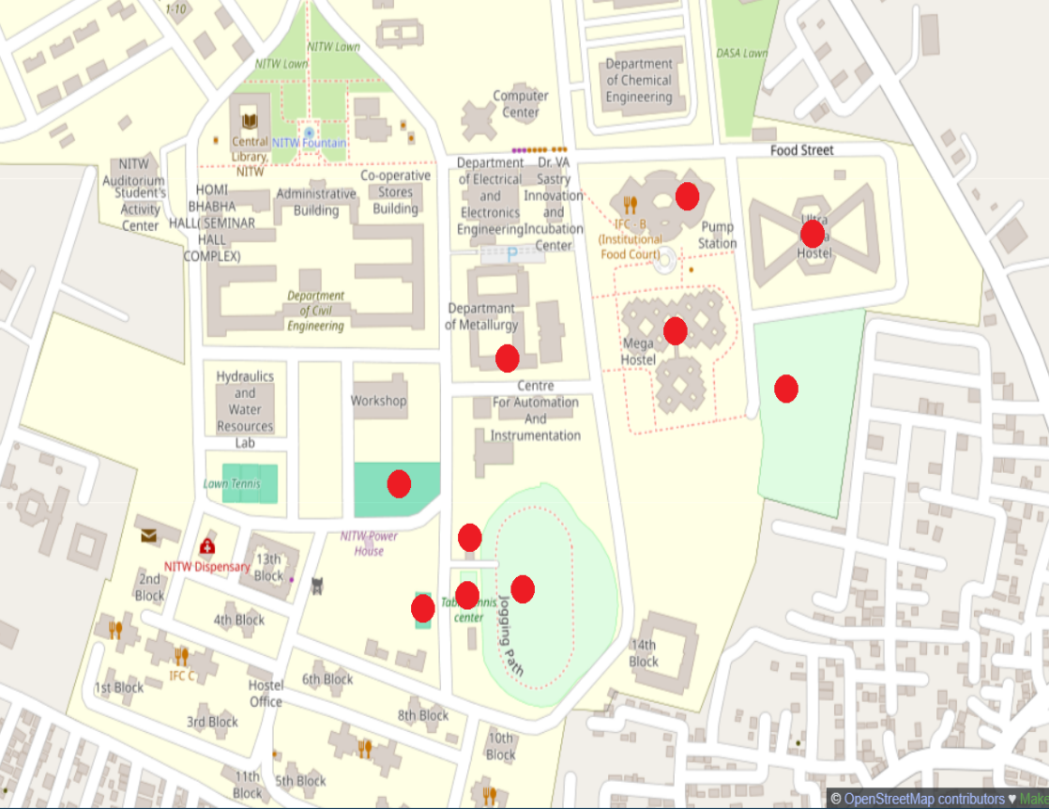
METHODOLOGY PART 4
Occupancy‑Driven Sampling and Temporal Distribution
Timed readings to match peak occupancy:
Dining halls at breakfast, lunch, dinner
Sports facilities on weekday vs. weekend
For March 2025, converted 15 min snapshots into daily averages.
Spread sampling over 2–3 weeks to avoid short‑term biases.

Slide 13
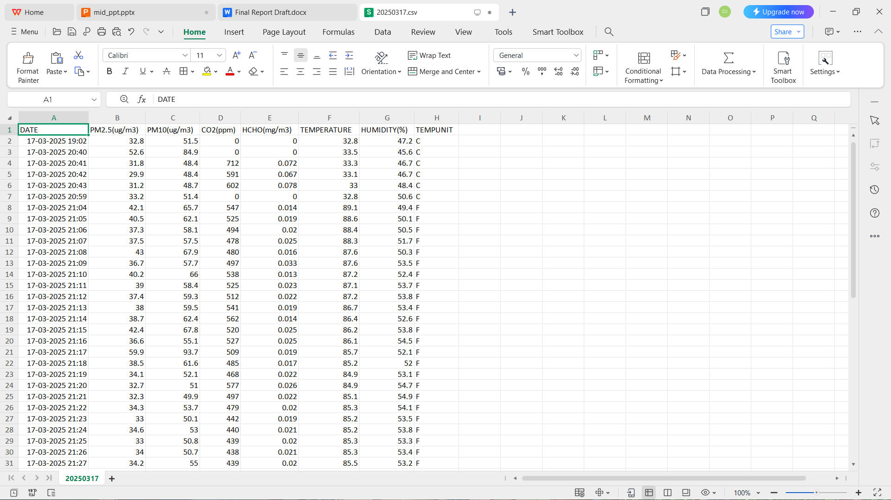
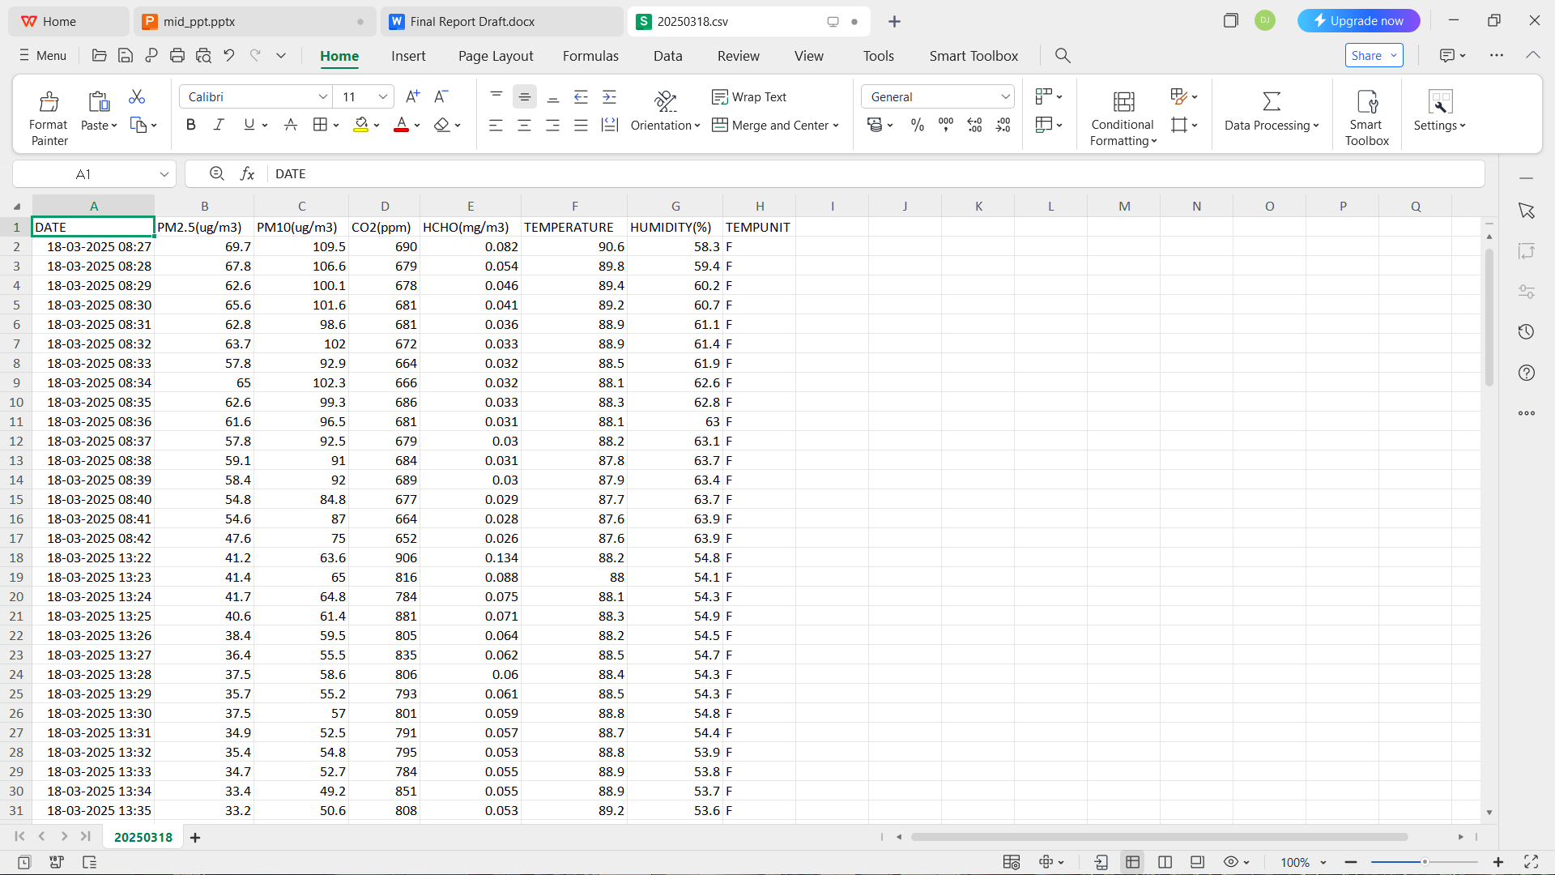
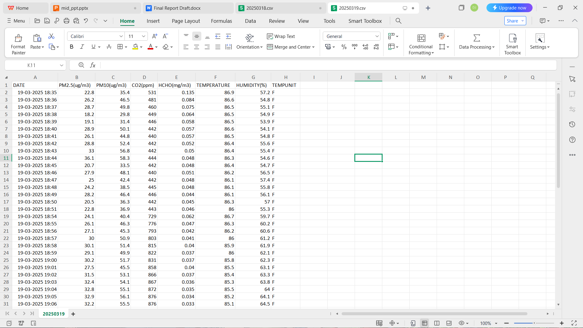
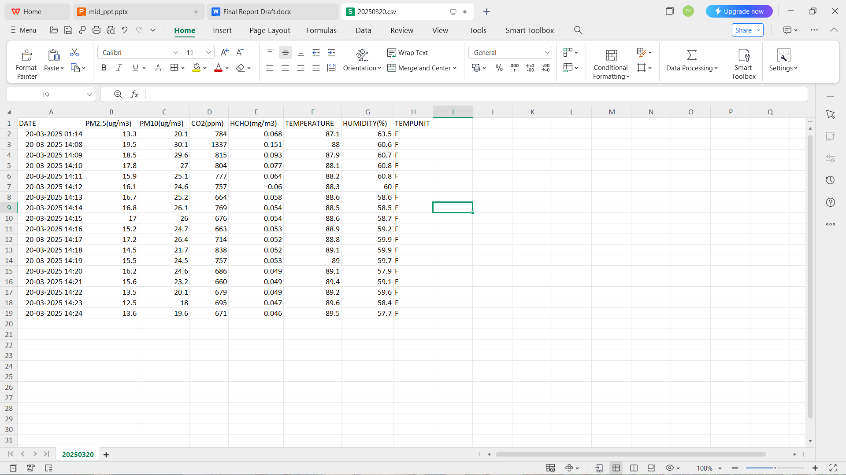
VARIOUS SAMPLES COLLECTED USING TEMTOP

Slide 14
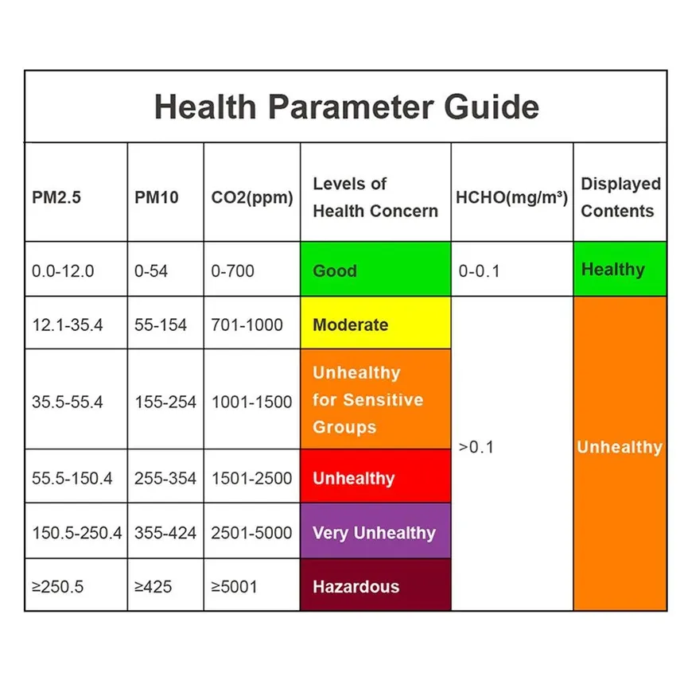
PARAMETERS AND THEIR HEALTH IMPLICATIONS (AS PER WHO GUIDELINES)

Slide 15

RESULTS & OBSERVATIONS

Slide 16
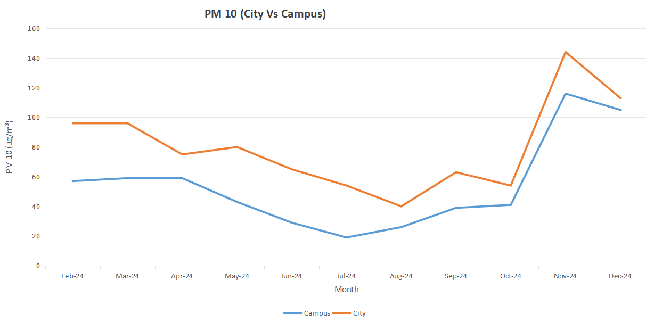
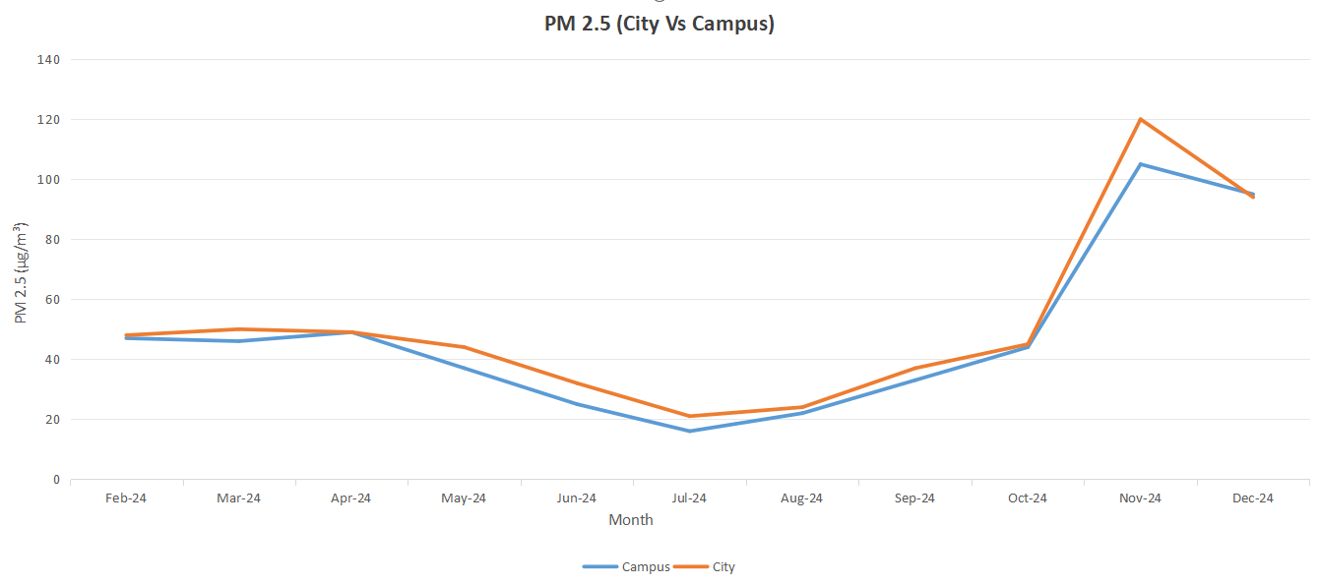
PM 2.5 & PM 10 Concentration Trends: NIT Warangal vs Balasamudram
Both sites exceeded WHO standards for PM 2.5 and PM 10, indicating shared regional pollution sources.
PM 2.5 levels showed strong similarity, highlighting fine particulate infiltration from urban and transport emissions.
PM 10 levels were consistently higher in Balasamudram due to traffic, construction, and urban dust, while the campus benefited from green cover and distance from direct sources.

Slide 17
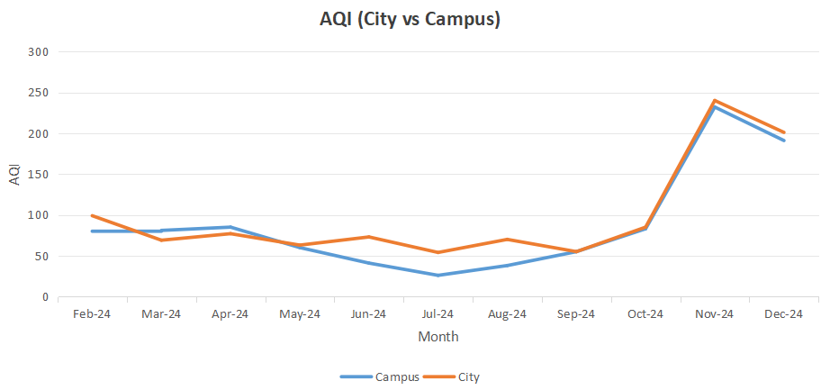
Ambient AQI Trends: NIT Warangal vs Balasamudram
AQI trends consistently breached WHO safe limits at both locations.
High correlation between AQI patterns at both sites signals common pollution origins.
Campus location offers partial mitigation but not immunity from regional air quality degradation.

Slide 18
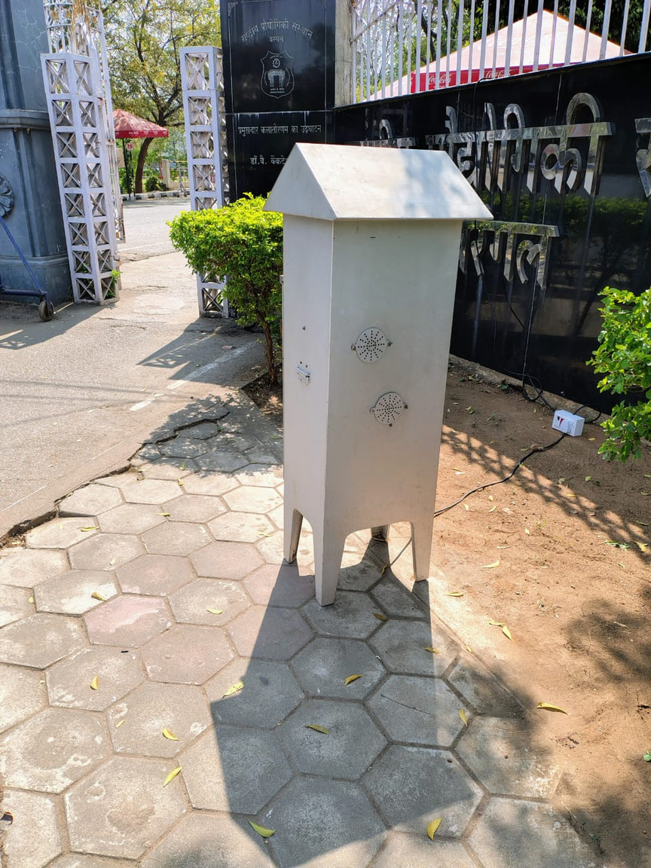

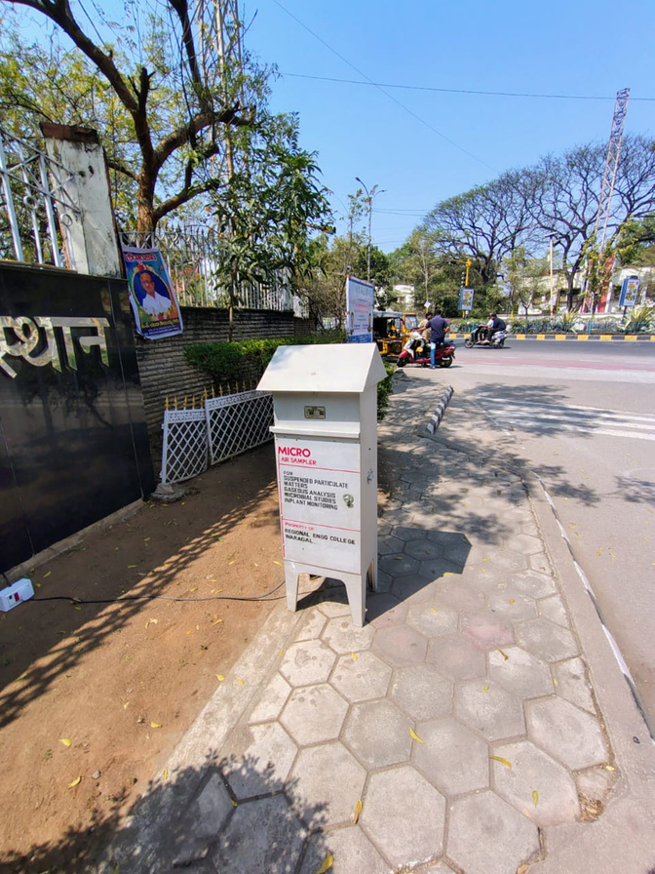

BOUNDARY AIR QUALITY ASSESSMENT (HVS DATA)
PM 10 concentrations at the campus boundary were recorded using HVS under controlled short-term sampling and scaled to 24-hour values.
Recorded PM 10 values, although slightly below urban hotspot levels, still exceeded WHO’s recommended safe thresholds, indicating substantial dust and coarse particulate infiltration from the nearby urban area.
Wind direction during sampling (northeast) confirmed boundary-level particulate transport into the campus, aligning with observed outdoor trends from the city.
Findings underline the role of perimeter sources and wind-driven transport in influencing campus air quality.

Slide 19
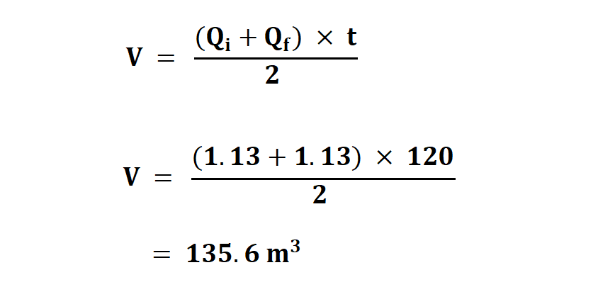
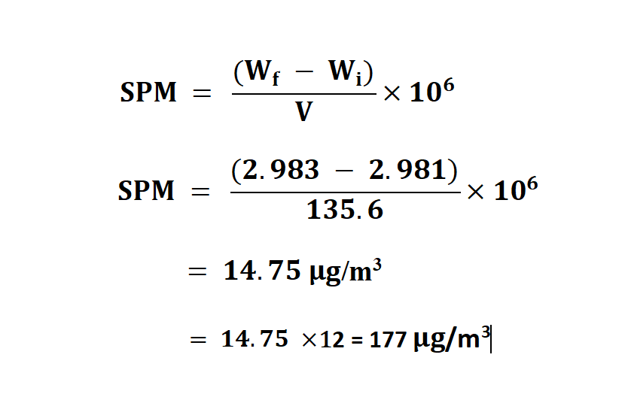
BOUNDARY AIR QUALITY ASSESSMENT (HVS DATA)
Air Volume Calculation:
Q1​ & Q2​ = Initial & Final Airflow (m³/min)
t = Sampling Time (minutes)
Mass Concentration of Suspended Particulate Matter (SPM):
W1​,W2​ = Initial & Final Filter Weights (grams)
V = Air Volume Sampled (m³)

Slide 20
CLOSED FACILITIES
Key Observations:
Formaldehyde (HCHO):
Generally within WHO limits (0.1 mg/m³) except in Classrooms, where poor ventilation and off-gassing from synthetic materials caused exceedances.
CO₂ Concentrations:
Gym, IFC A Dining Hall, and Classrooms exceeded the WHO 700 ppm benchmark, indicating overcrowding and insufficient ventilation.
Badminton Court stayed near or below the limit — thanks to its semi-open design allowing natural air exchange.
Particulate Matter (PM 2.5 & PM 10):
IFC A Dining Hall and Gym recorded the highest particulate levels, driven by dense occupancy, cooking emissions, and poor exhaust systems.
Classrooms and Badminton Court showed more stable and moderate levels due to fewer indoor sources and access to occasional natural ventilation.
Facilities Analyzed:
Academic Classrooms
IFC A Dining Hall
Gymnasium
Badminton Court

Slide 21
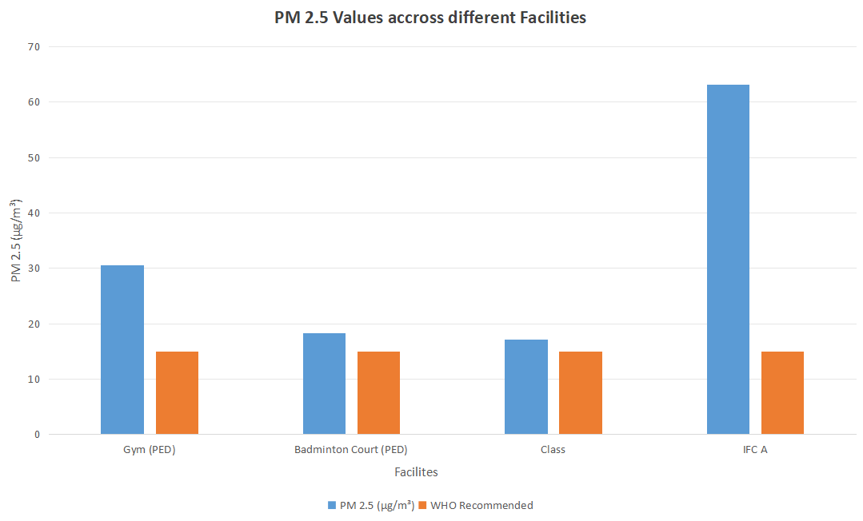
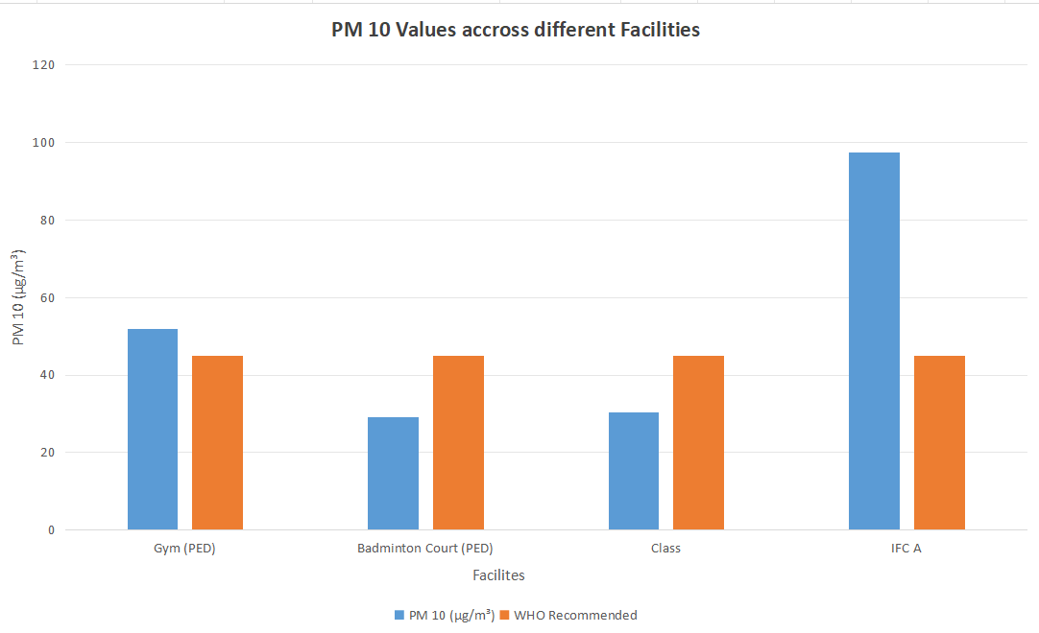
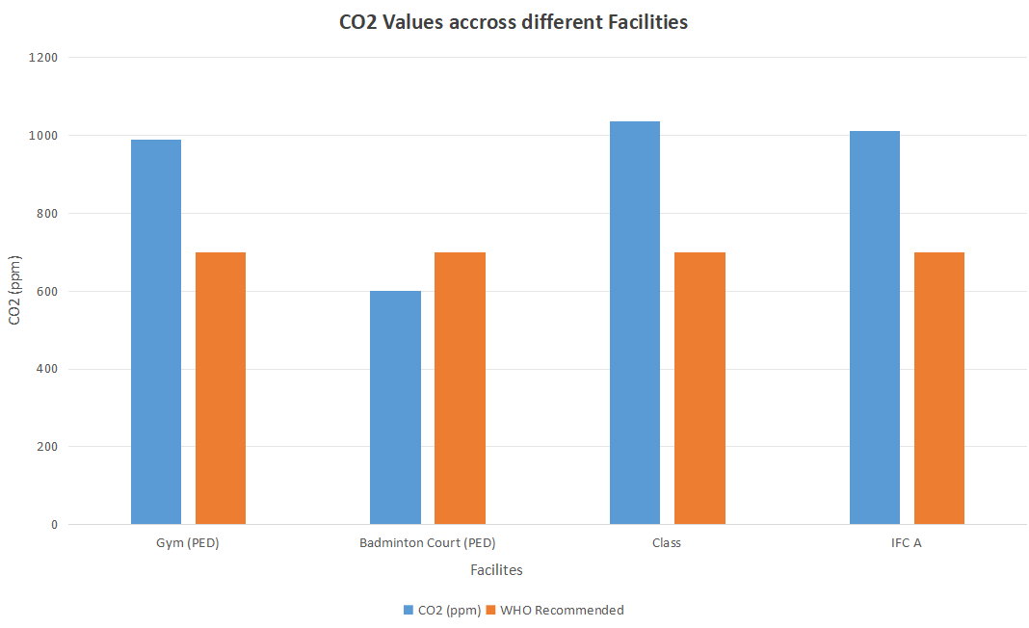
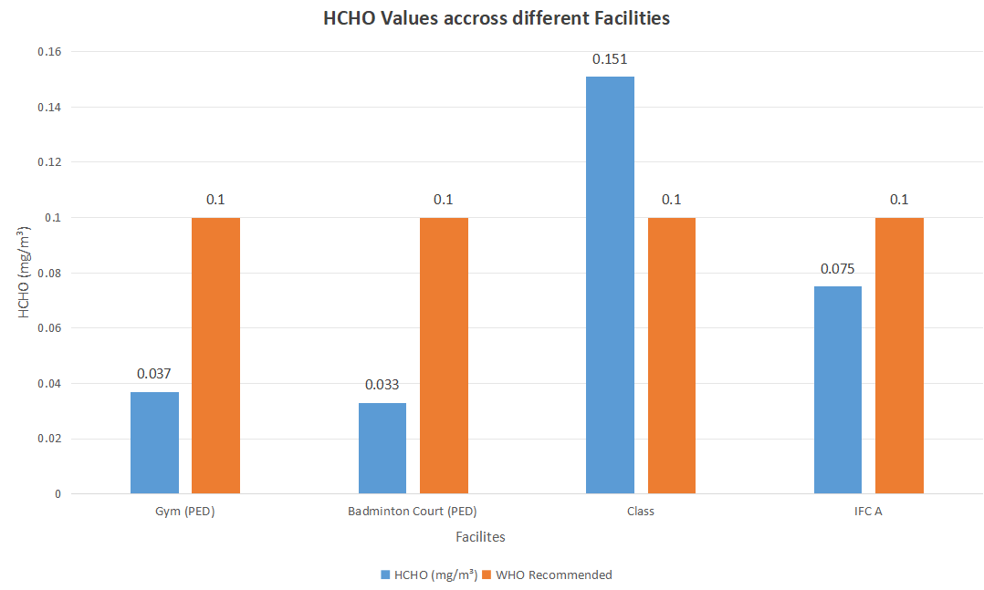
POLLUTANT CONCENTRATION PROFILES — CLOSED FACILITIES

Slide 22
OPEN FACILITIES
Key Observations:
Formaldehyde (HCHO):
Consistently below WHO’s recommended limit (0.1 mg/m³) across all open facilities, due to minimal indoor pollutant sources and unrestricted air dispersion.
CO₂ Concentrations:
Well within WHO’s 700 ppm limit in all locations, confirming strong natural ventilation and continuous air exchange even during high occupancy.
Particulate Matter (PM 2.5 & PM 10 ):
Main Stadium and 1K Ground recorded the highest concentrations, nearly triple the WHO limit for PM2.5 and exceeding PM10 limits — likely due to exposure to vehicle emissions, dust, and limited tree cover.
Volleyball Court and Basketball Court showed more moderate levels, likely thanks to surrounding vegetation and partial shielding from external pollution.
Facilities Analyzed:
Volleyball Court
Main Stadium
1K Ground
Basketball Court

Slide 23
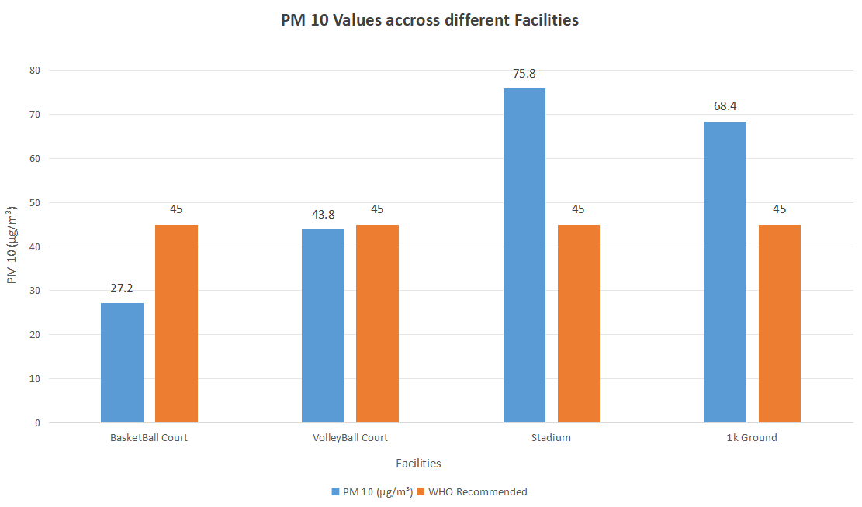
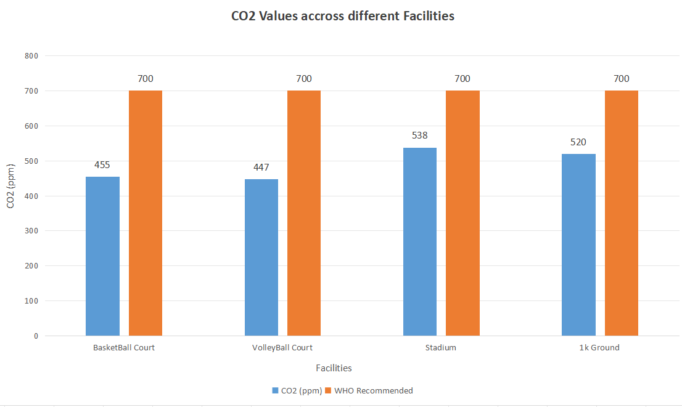
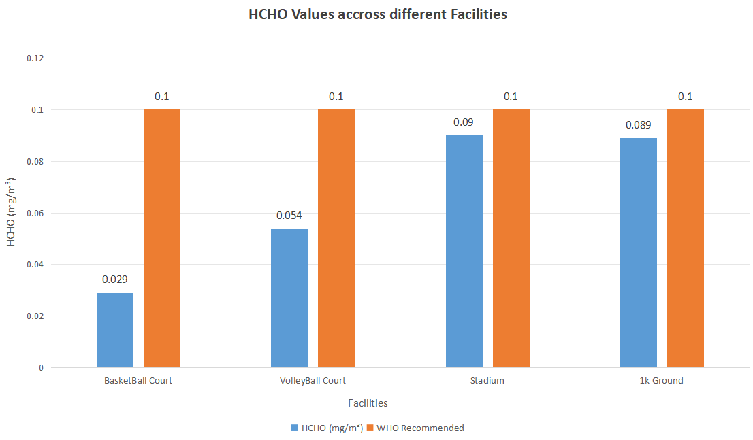
POLLUTANT CONCENTRATION PROFILES — OPEN FACILITIES

Slide 24
VERTICAL FACILITY ANALYSIS
Key Observations:
Particulate Matter (PM 2.5 & PM 10):
Both hostels recorded PM 2.5 and PM 10 levels above WHO limits (15 µg/m³ for PM 2.5 and 45 µg/m³ for PM 10) on all floors.
1K Hostel: Highest concentrations on the Ground Floor — likely due to proximity to vehicle pathways, dust sources, and pedestrian movement.
1.8K Hostel: Particulate levels increased with floor height — hinting at wind-driven pollutant transport and accumulation at upper floors.
CO₂ Concentrations:
Both hostels maintained CO₂ levels well within WHO’s 700 ppm limit across all floors.
Indicates adequate ventilation and limited buildup of human-generated CO₂ even at full occupancy.
Formaldehyde (HCHO):
Consistently below WHO limit (0.1 mg/m³) for both hostels, on all floors.
Suggests low emissions from furniture, construction materials, and good indoor air exchange.
Facilities Analyzed:
1K Hostel (Kakatiya Hall of Residence)
1.8K Hostel (Ramappa Hall of Residence)

Slide 25
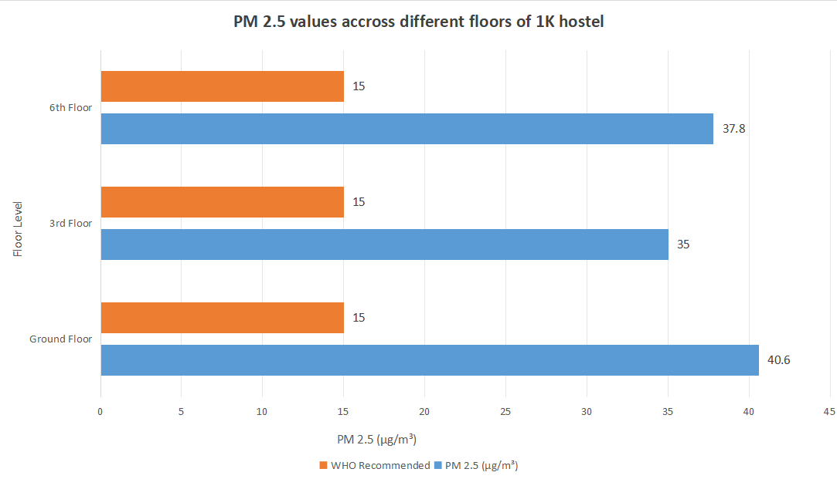
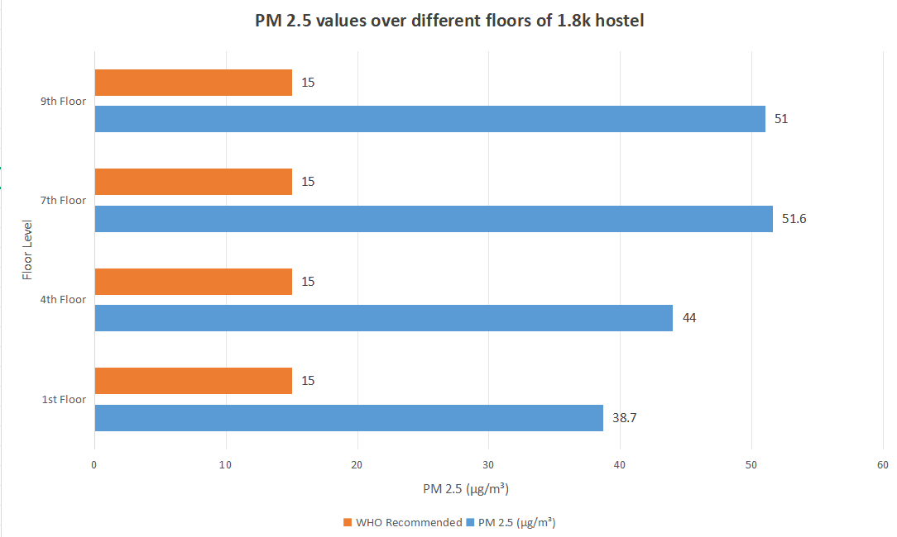
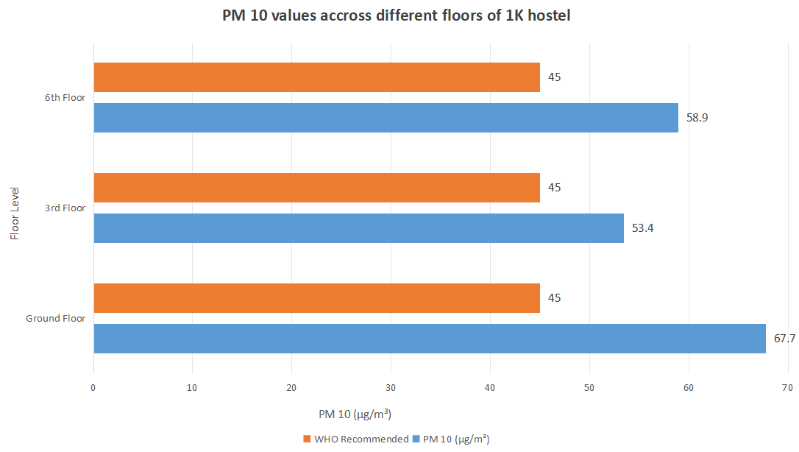
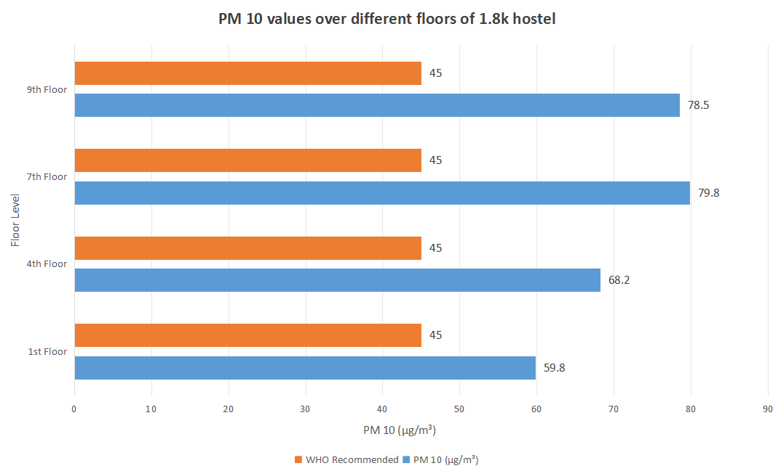
VERTICAL DISTRIBUTION OF PARTICULATE MATTER (PM₂.₅ & PM₁₀) — 1K VS 1.8K HOSTELS

Slide 26
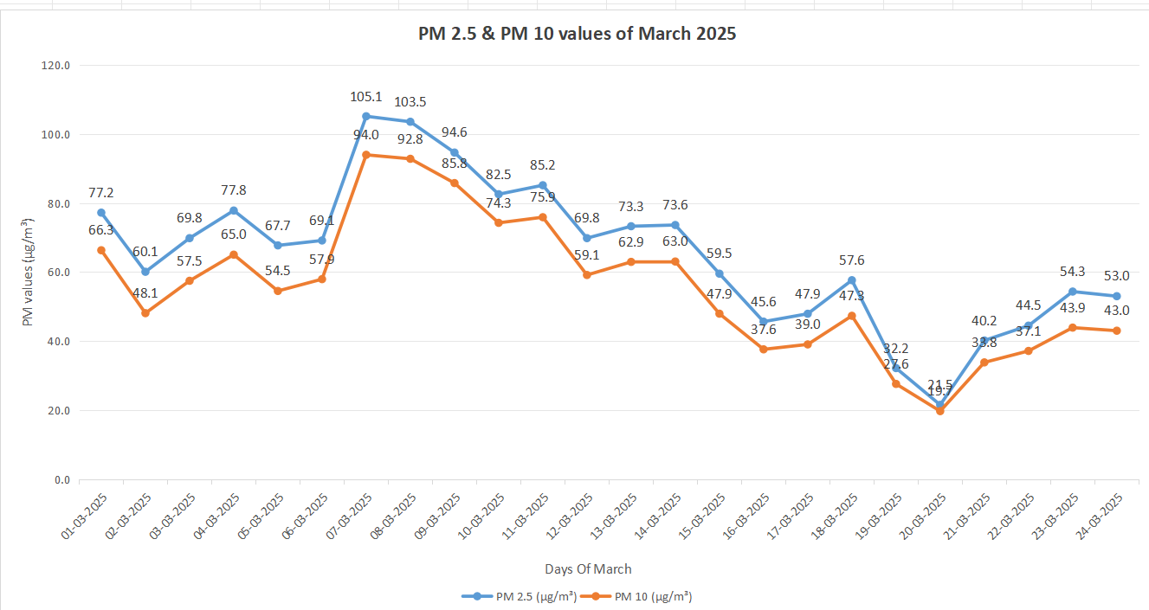
TEMPORAL VARIATION IN MARCH 2025 — IMPORTANCE OF DISTRIBUTED SAMPLING
Air pollution levels showed significant daily fluctuation throughout March 2025, peaking mid-month before declining.
Short-term or single-day readings risk misrepresenting air quality due to these natural variations.
For accurate assessment, readings must be spread across 2–3 weeks — as supported by previous research.
Measurements near minimum points should be flagged or scaled to avoid underestimating exposure risk.

Slide 27
INDOOR AIR VS. REGULATORY BENCHMARKS:
WHO 2021 & NAAQS 2009
WHO 2021 tightened its 24 - hr limits to protect health, while NAAQS 2009 remains more lenient.
NIT Warangal indoor PM 2.5 /PM 10 regularly exceeds even the Indian standards and far surpasses WHO’s.
This table highlights the severity and the urgent need for IAQ interventions.
POLLUTANT | WHO 2021 (24 hr avg) | NAAQS 2009 (24 hr avg) | NITW (OBSERVED)
PM 2.5 | 15 µg/m³ | 60µg/m³ | 40–90 µg/m³
PM 10 | 45 µg/m³ | 100 µg/m³ | 80–150 µg/m³

Slide 28
CONCLUSION
Air pollution is present across all campus microenvironments, influenced by wind, design, and occupancy.
Wind direction shifts (NE to SE) significantly alter pollution patterns — front-facing areas are more exposed.
Poor ventilation in closed spaces (classrooms, dining halls, gyms) leads to pollutant buildup, especially CO₂ and PM.
Indoor air often exceeds WHO guidelines for PM2.5, PM10, and CO₂, particularly in high-occupancy zones.
Building design, occupancy, and ventilation are key drivers of air quality differences across campus.

Slide 29
RECOMMENDATIONS
Ventilation Upgrades: Improve mechanical systems in high-traffic closed spaces to reduce pollutant accumulation.
Real-Time Monitoring: Deploy CO₂ and PM sensors for dynamic ventilation control and early warnings.
Green Infrastructure: Increase vegetation around open and boundary areas to filter dust and airborne pollutants.
Routine Air Audits: Institutionalize periodic monitoring with devices like Temtop to guide action.
Data-Driven Planning: Use air quality data for smarter resource allocation and safer facility design.
Policy Advocacy: Push for indoor air quality regulations in educational institutions.
Future Research: Expand pollutant scope (VOCs, NO₂, O₃) and run longer-term studies to capture seasonal dynamics.

Slide 30
CHALLENGES AND LIMITATIONS
Seasonal Variability: Changing weather makes year-round air quality hard to predict.
Wind Dynamics: Shifting wind alters pollutant spread — front-facing buildings suffer more, shielded zones stay cleaner.
Indoor Air Quality Fluctuations: IAQ changes with occupancy, ventilation habits, and time of day.
Instrument Limitations: Portable monitors are expensive and less accurate for open spaces; larger, more precise tools are often needed.

Slide 31
REFERENCES
Asrani, S., & Shah, D. (2024). Review on indoor air quality in Indian buildings. Retrieved from https://www.researchgate.net/publication/352894464_Review_on_indoor_air_quality_in_Indianbuildings
Datta, A., Suresh, R., Gupta, A., Singh, D., & Kulshrestha, P. (2017). Indoor air quality of non residential urban buildings in Delhi. International Journal of Sustainable Built Environment, 6, 412–420.
Sahu, R., Dixit, K. K., Mishra, S., Kumar, P., Shukla, A. K., Sutaria, R., Tiwari, S., & Tripathi, S. N. (2020). Validation of low cost sensors in measuring real time PM₁₀ concentrations at two sites in Delhi National Capital Region. Sensors, 20(5), 1347. https://doi.org/10.3390/s20051347
Singh, P., Arora, R., & Goyal, R. (2017). Indoor air quality assessment in selected schools of DelhiNCR, India. International Journal of Applied Home Science, 4(5–6), 389–394.
Sahu, R., Dixit, K. K., Mishra, S., Kumar, P., Shukla, A. K., Sutaria, R., Tiwari, S., & Tripathi, S. N. (2020). Validation of low cost sensors in measuring real time PM₁₀ concentrations at two sites in Delhi National Capital Region. Sensors, 20(5), 1347. https://doi.org/10.3390/s20051347
Temtopus. (2024). Temtop M2000 2ndGeneration Portable Air Quality Monitor for PM₂.₅, PM₁₀, CO₂, and HCHO. Retrieved from https://temtopus.com/products/temtop-m2000-2nd-generation-air-quality-monitor-for-pm2-5-pm10-particles-co2-hcho-temperature-humidity-settable-audio-alarm-data-export-recording-curve-easy-calibration

Slide 32

THANK YOU
20 Feb, 2025

